Slide 1

INTERNET CAFE
NETWORK DESIGN PROPOSAL FOR INTERNET CAFE

Slide 2
INTRODUCTION
Project Objective
Design an efficient and secure network for an Internet café with 30 users sharing a single ADSL internet connection.
Implement a web filtering system to block inappropriate websites.
Include billing software to monitor customer accounts and usage time.
Proposed Network Design
Ensure reliable, high-speed, and stable internet connectivity.
Provide secure and well-managed access for all users.
Include:
Requirement analysis
Network diagram
IP addressing plan
List of recommended hardware and software

Slide 3
REQUIREMENTS
Device | IP Address | Subnet Mask | Default Gateway
PC1-PC30 | 192.168.1.3 to 192.168.1.33 (DHCP) | 255.255.255.0 | 192.168.1.0
PC-ADMIN | 192.168.1.2 (Static) | 255.255.255.0 | 192.168.1.1
Switch 0 | DHCP | DHCP | DHCP
Switch 1 | DHCP | DHCP | DHCP
Lan Router | 200.0.0.1 | 255.255.255.0 | 200.0.0.0
Server0 | 192.168.1.1 | 255.255.255.0 | 192.168.1.0
Server1 | 200.0.0.10 | 255.255.255.0 | 200.0.0.0
ADSL Modem | N/A | N/A | N/A
Cloud | N/A | N/A | N/A
Connectivity: The network must support 30 users sharing a single ADSL internet connection with a minimum bandwidth of 20 Mbps.
Web Filtering: Implement a web filtering device or software to block inappropriate websites and ensure safe browsing.
Billing System: Use billing software to manage customer accounts, track usage, and generate bills efficiently.
Security: Design the network to provide secure connectivity and protect against unauthorized access or data breaches.
Redundancy and Backup: Include backup and redundancy plans to maintain continuous service in case of equipment failure or network issues.
Scalability: Ensure the network is scalable to support future growth and additional users.
Cost-Effectiveness: Develop a cost-effective solution that meets all technical and operational requirements while maintaining reliability and performance.

Slide 4
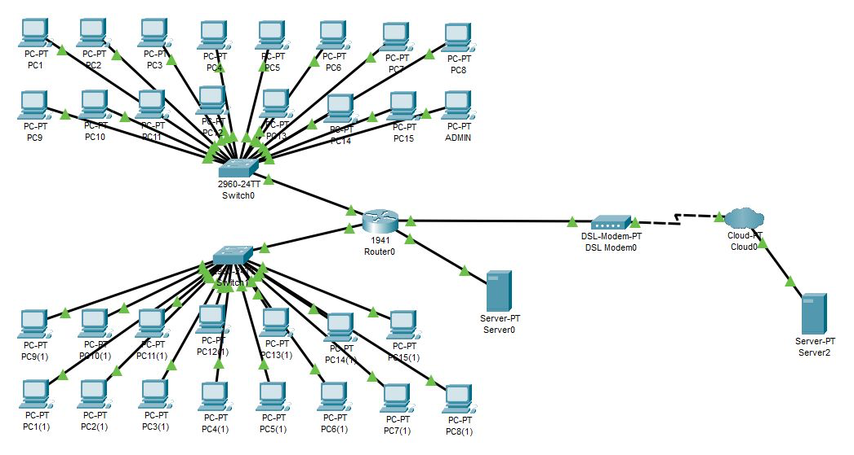
TOPOLOGY

Slide 5
FEATURES
1. DHCP (Dynamic Host Configuration Protocol)
DHCP gives IP addresses automatically to devices when they join a network. It makes setup easy and avoids IP address conflicts.
2. VLAN (Virtual Local Area Network)
VLAN divides one big network into smaller parts. It helps improve speed, security, and makes the network easier to manage.
3. SMTP (Simple Mail Transfer Protocol)
SMTP is used to send emails from one computer to another. It’s what allows email messages to travel over the internet.
4. Subnetting
Subnetting breaks one large network into smaller ones. This helps control traffic, improve performance, and keep the network organized.

Slide 6
FEATURES
5. DNS (Domain Name System)
DNS changes website names (like google.com) into numbers (IP addresses) that computers understand. It helps users access websites easily.
7. HTTPS (Hypertext Transfer Protocol Secure)
HTTPS is a safe way to transfer data on websites. It keeps information private and protects it from hackers.
8. FTP (File Transfer Protocol)
FTP is used to upload or download files between computers over the internet. It helps transfer data easily from one place to another.

Slide 7
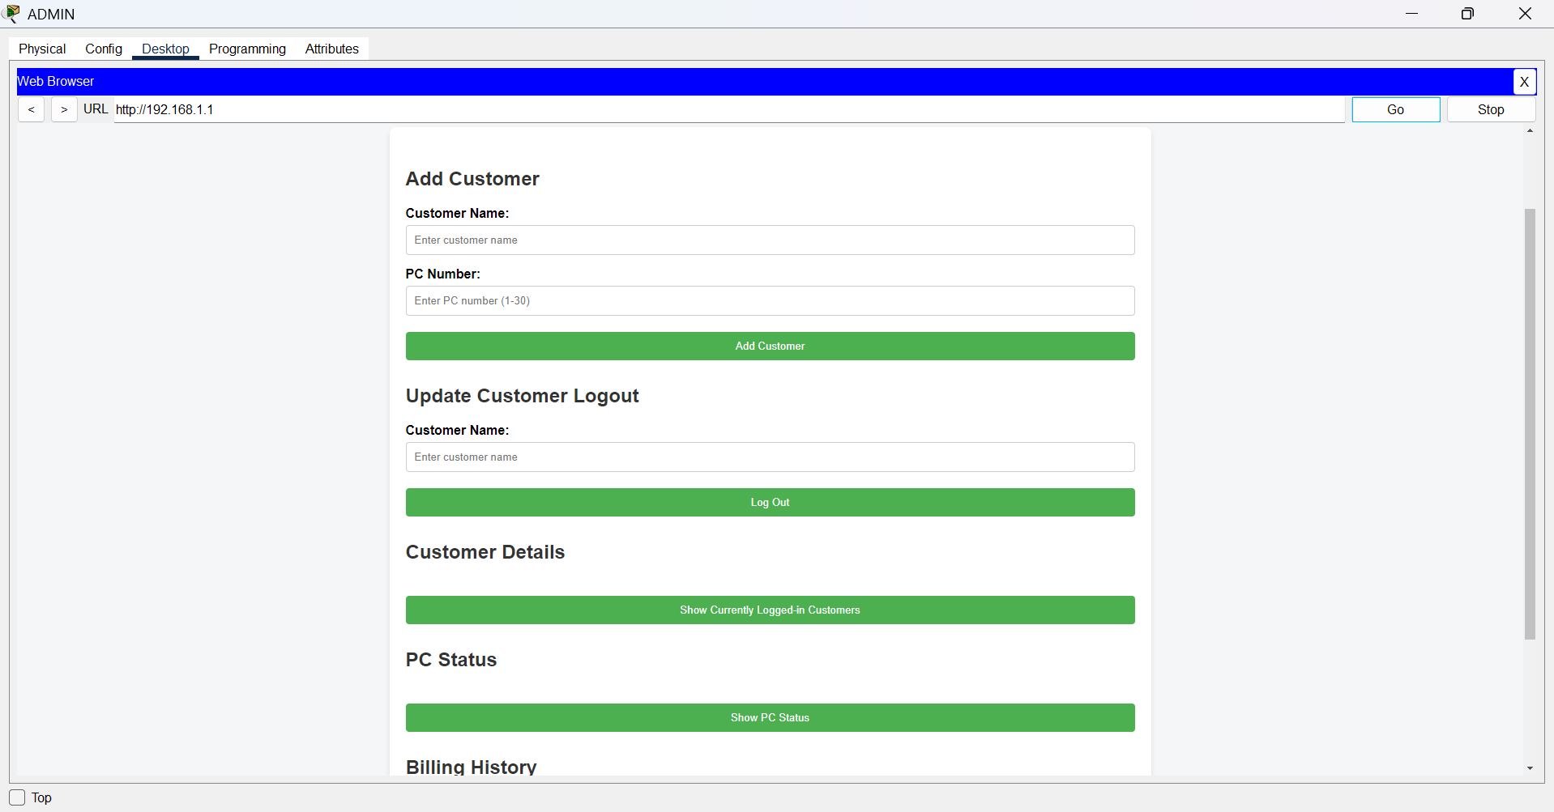
RUNTIME DEMO
After setting up the network, all PCs in the Internet café should be able to connect to the internet through the server. To check this, open a web browser on any PC and visit a website if it loads, the connection is working.
The internet speed and performance depend on the ISP, network equipment, and the number of users online at the same time. If any connection problems occur, they should be fixed quickly to ensure customers have a smooth browsing experience.

Slide 8

Cost-Benefit Analysis
The setup may have a high initial cost, but it offers a good return on investment.
A fast and stable internet connection will attract more customers and increase revenue.
Strong security features will help prevent data breaches and legal issues.
The design is cost-effective in the long run.
It will improve security, enhance customer experience, and boost the café’s income.

Slide 9
CONCLUSION
In conclusion, the proposed network design for the Internet café supports 30 users and provides secure, reliable, and efficient internet access. It includes web filtering to ensure safe browsing and billing software to manage customer accounts easily. The design also covers requirement analysis, a network diagram, IP address planning, and recommended hardware and software. Overall, it offers a scalable, secure, and cost-effective solution that meets the café’s needs now and in the future.

Slide 10
THANK YOU!

